Slide 1
Microprocessors, Microcontrollers, and Embedded
Systems

Slide 2
BASIC I/O in ATmega32/16

Slide 3
Ports for I/O
4 different ports for I/O
A, B, C, D
8 bit <-> 8 data pins
Every pin is bidirectional, can be used as input or output

Slide 4
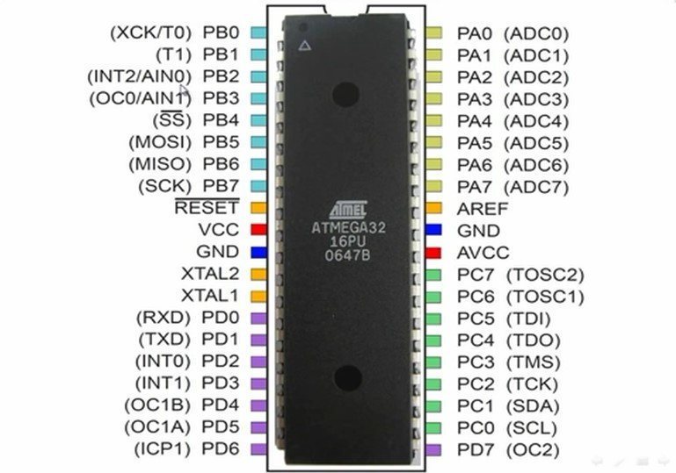

Slide 6
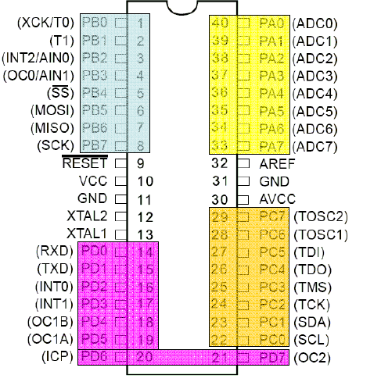
I/O Ports of ATmega32 (AVR)

Slide 7
Port Operation Registers
DDRx – Data Direction Register
PORTx – Pin Output Register
PINx – Pin Input Register

Slide 8
Configuration
For configuration we have to use the Data Direction Registers
One register for each port
DDRx (DDRA, DDRB, DDRC, DDRD)
Configures each pin as input or output
Pin configuration
Input – 0
Output – 1

Slide 9
C Code Example
DDRA = 0b11111111;
Sets each bit of port A as output
DDRB = 0b00000000;
Sets each bit of port B as input
DDRC = 0b01010101;
???

Slide 10
Input
You have to read the PINx register
unsigned char ch; ch = PINA;
What to do if only some of the pins are configured as input ??

Slide 11
Output
You have to use the PORTx register
PORTB = 0b11111111;
What to do if only some of the pins are configured as output ??

Slide 12
Write a simple program to set the port B to 0xFF

Slide 13
C Code
#include <avr/io.h>
int main(void)
{
DDRD = 0b11111111; //initializing portD in //output mode
PORTD = 0b11111111;//writing value to portD
while(1)
{
//TODO:: Nothing
}
}

Slide 14
What will this code do ??
#include <avr/io.h>
int main(void)
{
DDRD = 0b01111111;
PORTD = 0b11111111;
while(1)
{
//TODO:: Nothing
}
}

Slide 15
Write a simple program to blink a LED on port B pin 0

Slide 16
C Code
#include <avr/io.h>
int main(void)
{
unsigned char c = 1;
DDRB= 0b00000001;
while(1)
{
PORTB = c;
if(c) c = 0;
else c = 1;
delay();
}
}
void delay()
{
unsigned char i,j,k;
for(i=0;i<255;i++)
for(j=0;j<255;j++)
for(k=0;k<100;k++);
}

Slide 17
Write a simple program to animate 8 LEDs connected to PORT B
One LED at a time is ON
The rest are off
At first LED 0 is on, then LED 1, and so on.

Slide 18
C Code
int main(void)
{
unsigned char c = 0x01;
DDRB= 0xFF;
while(1)
{
PORTB = c ;
if(c==1<<7)c = 1;
else c = c << 1;
delay();
}
}

Slide 19
Accurately Generating Delay
#include <avr/io.h>
#define F_CPU 1000000 // Clock Frequency
#include <util/delay.h>
int main(void)
{
while(1)
{
//1000 ms delay
_delay_ms(1000);
}
}

Slide 20
Simple Input
A 8 bit input is connected to PORT A
Show the input state on PORT B

Slide 21
C Code
int main(void)
{
unsigned char c;
DDRA = 0x00;
DDRB = 0xFF;
while(1)
{
c = PINA;
PORTB = c ;
}
}

Slide 22
Simple Counter
PA0 is connected with push button
1 when pressed
PORT B connected to 8 LEDs
Increment count when pressed the push button

Slide 23
C Code
int main(void)
{
unsigned char c=0,in=0;
DDRA = 0xFE;
DDRB = 0xFF;
PORTB = c;
while(1)
{
in = PINA;
if(in & 0x01)
{
c++;
PORTB = c; }
}
}

Slide 24
Switch Bouncing
Non-ideal behavior of any switch which generates multiple transitions of a single input.
Causes problems while we are dealing with the logic or digital circuits.

Slide 25
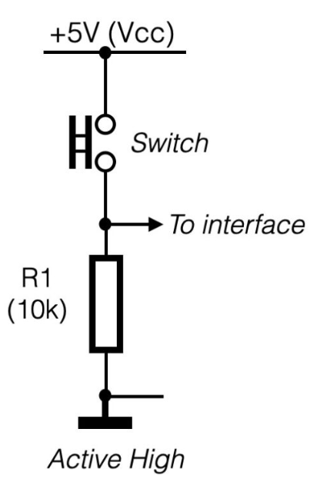
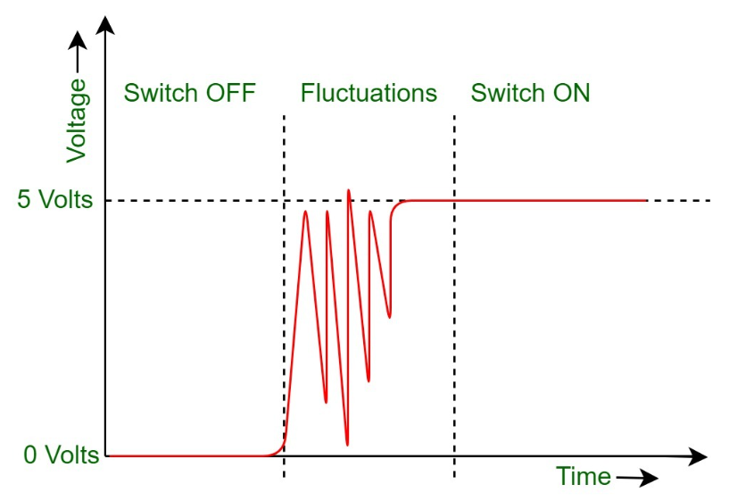
Switch Bouncing

Slide 26
C Code - Debouncing
int main(void)
{
unsigned char c=0,in=0;
DDRA = 0xFE;
DDRB = 0xFF;
PORTB = c;
while(1)
{
in = PINA;
if(in & 0x01)
{
c++;
PORTB = c; _delay_ms(1000);
}
}
}

Slide 27
Write a program to read a byte from PORT A and write it to PORT B
Exercise

Slide 28
If input (taken from PORTC) is less than 100, send it to PORTB, otherwise, send it to PORTD
Exercise

Slide 29
Write a program to read a byte from PORT A and write its upper nibble to PORT B (lower nibble) and lower nibble to PORT C (upper nibble)
Exercise

Slide 30
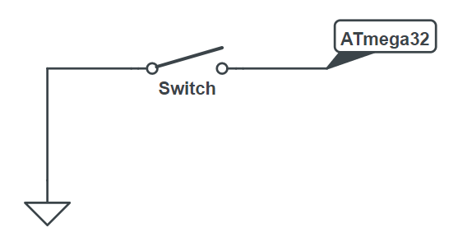
Discussions on push buttons
This might seem like the reasonable connection
What is wrong with it?

Slide 31
Discussions on push buttons
When switch is disconnected, input state can be HIGH or LOW
This phenomena is referred to as floating

Slide 32
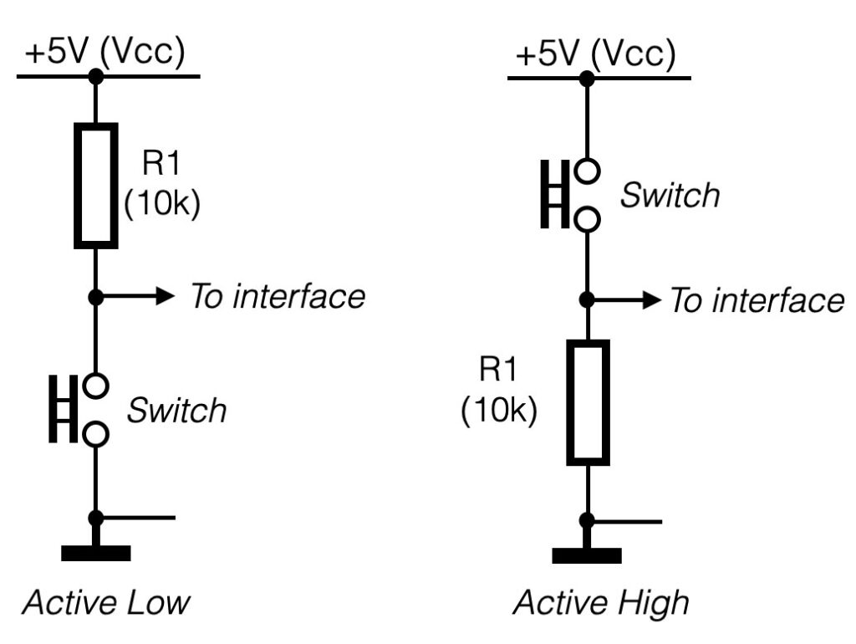
Handle Floating

Slide 33
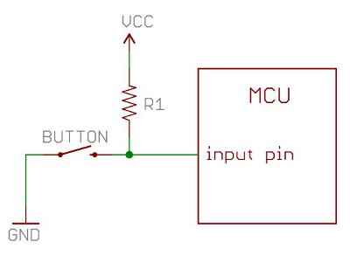
Pull-Up Resistor

Slide 34
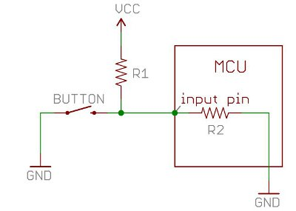
A deeper look

Slide 35
A deeper look
When the button is not pressed, the input pin is pulled high. The value of the pull-up resistor controls the voltage on the input pin.
R1 must be smaller enough than R2 to drop less voltage across R1

Slide 36
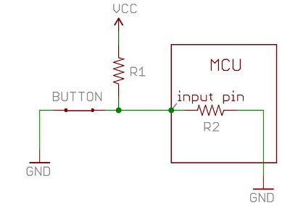
A deeper look
When the button is pressed, the input pin is pulled low. The value of resistor R1 controls how much current we want to flow from VCC, through the button, and then to ground.
Large R1 causes more power consumption

Slide 37
A deeper look
Because of the two opposing factors the resistor value cannot be too high not too less
R1 can be about 1/10th of R2

Slide 38
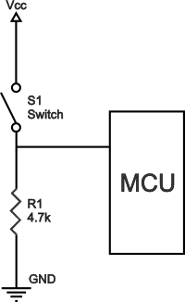
Pull Down Resistor

Slide 39
Enable Internal Pull-Up
If PORTxn is written logic one when the pin is configured as an input pin, the pull-up resistor is activated.
Here, x = A,B,C, or D
n is bit number, e.g., 0,1,2,..., or 7

Slide 40
Enable Internal Pull-Up
DDRA = 0b11110000;
PORTA = 0b11111111;

Slide 41
General Discussion
If some pins are unused, it is recommended to ensure that these pins have a defined level.
The simplest method to ensure a defined level of an unused pin, is to enable the internal pullup.

Slide 42
Readable Code
Use defined constants instead of immediates if possible
They are defined in header files (e.g. io.h)
PORTA = PORTA | (1 << 3)
PORTA = PORTA | (1 << PORT3)
https://github.com/hexagon5un/AVR-Programming/blob/master/AVR-Programming-Library/portpins.h

Slide 43
Resources
DataSheet
Pull-Up and Pull-Down Resistors
http://www.resistorguide.com/pull-up-resistor_pull-down-resistor/
More on Pull-Up and Pull-Down resistors
https://learn.sparkfun.com/tutorials/pull-up-resistors

Slide 44
☺

